Slide 1


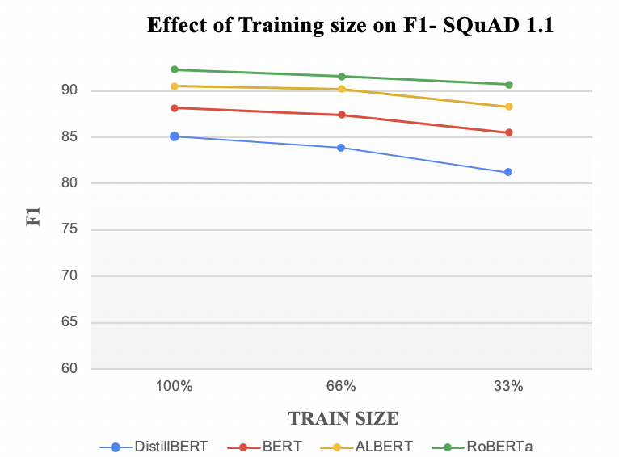
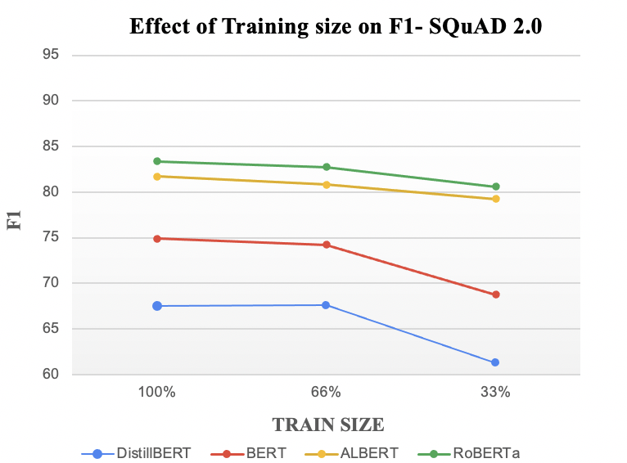
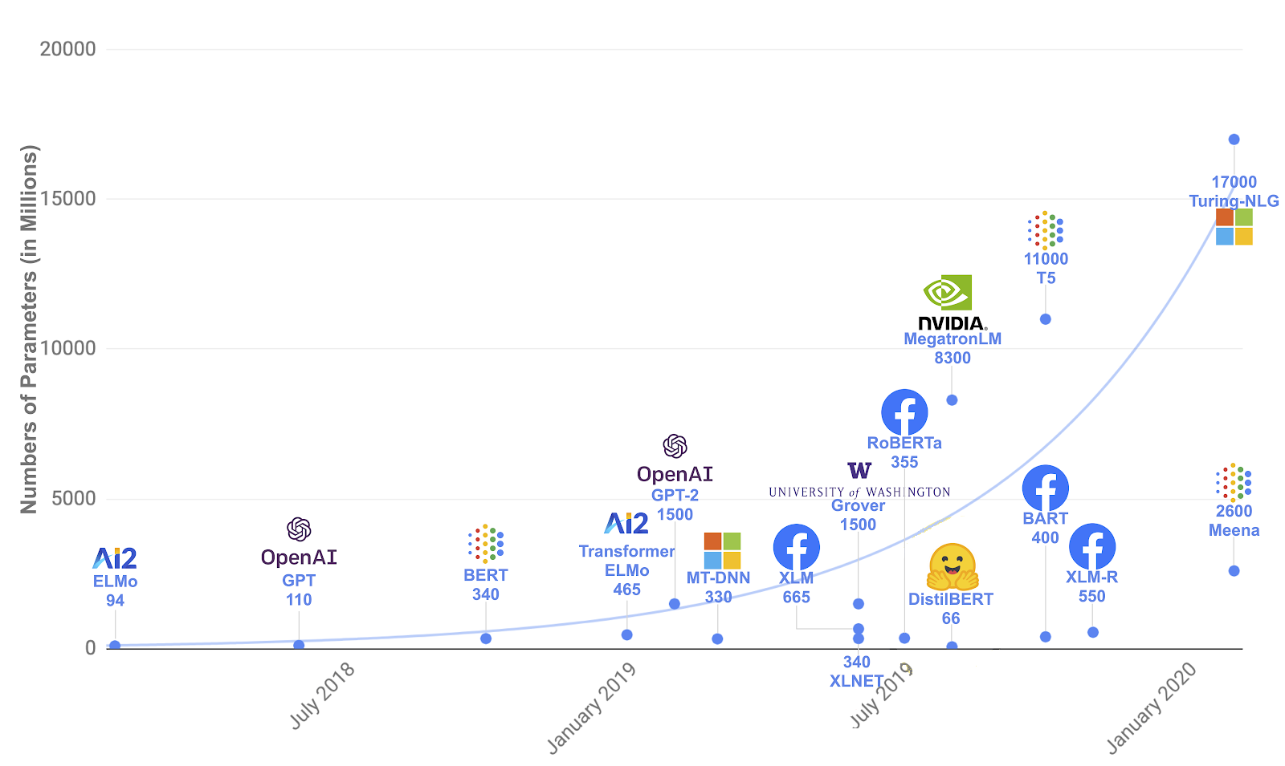
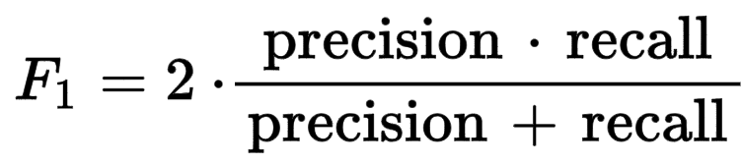
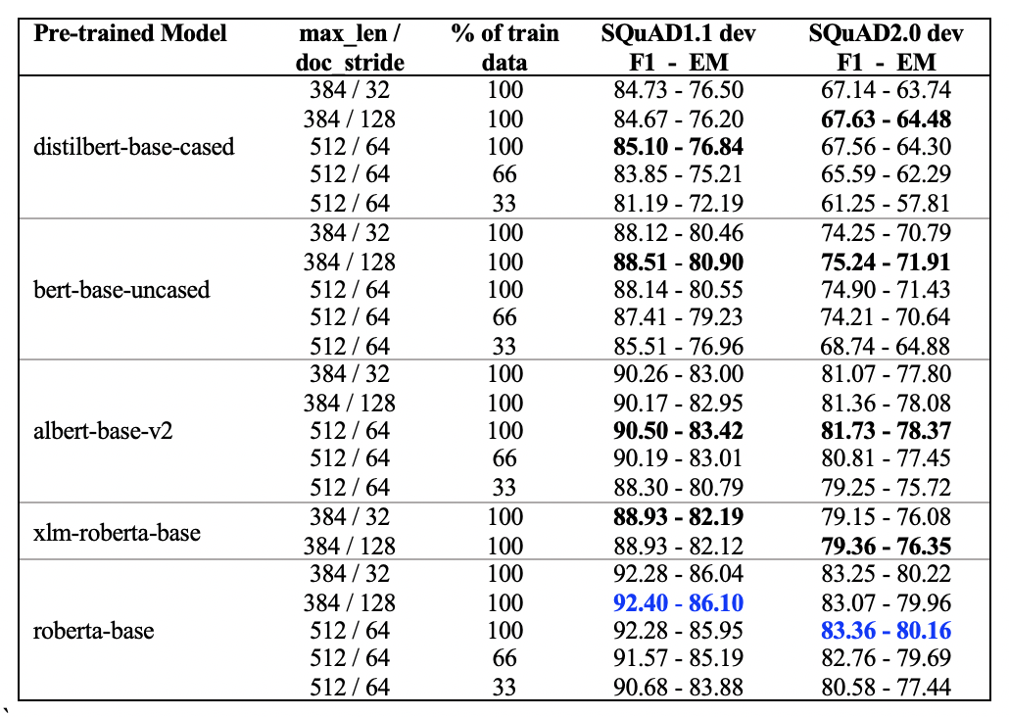
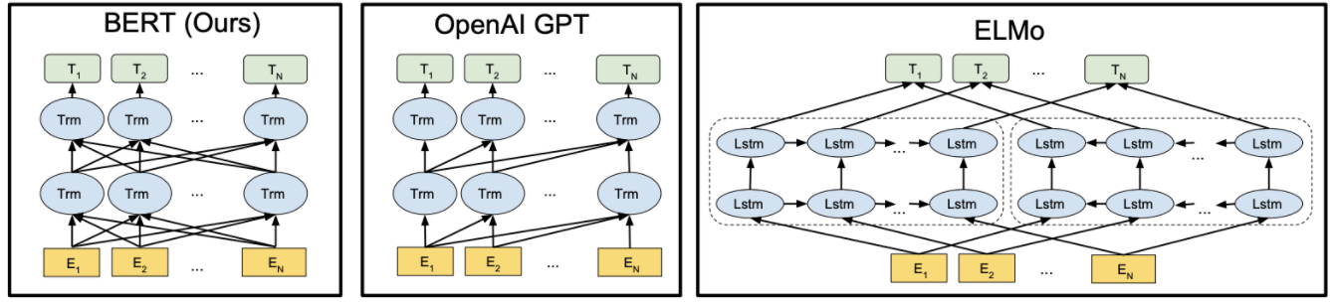
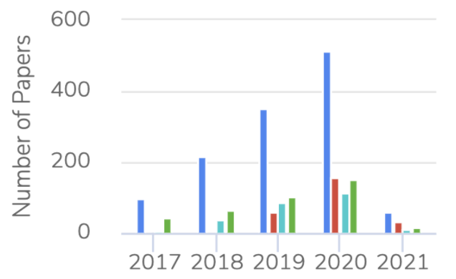
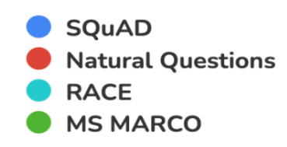
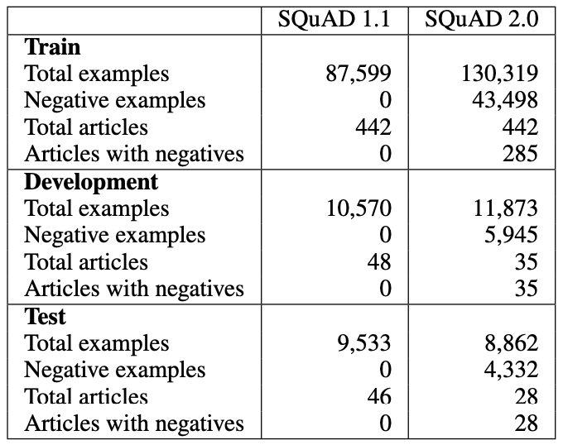
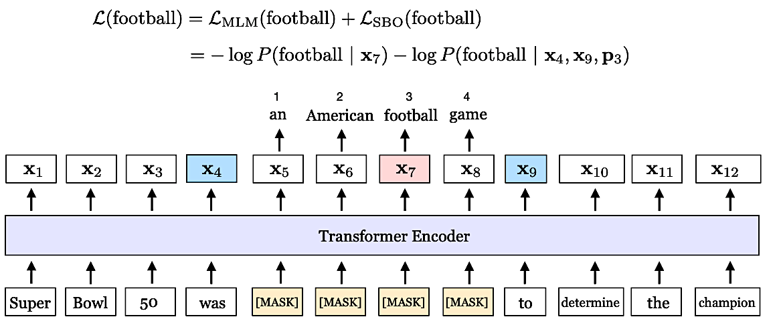
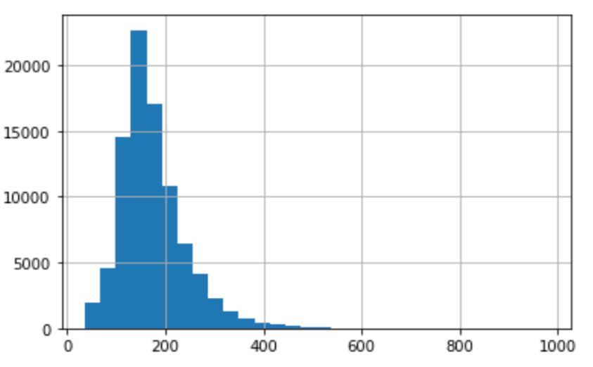
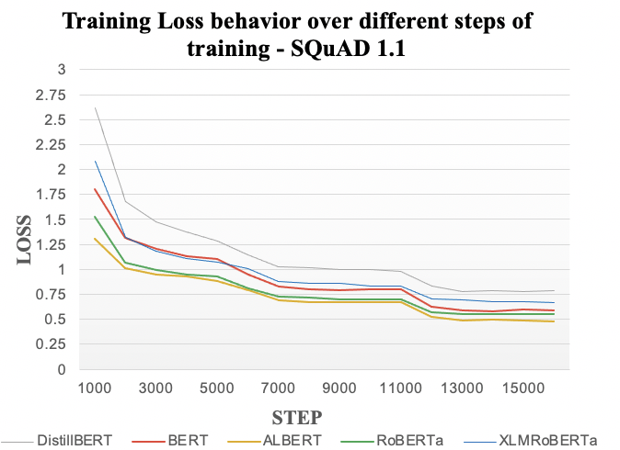
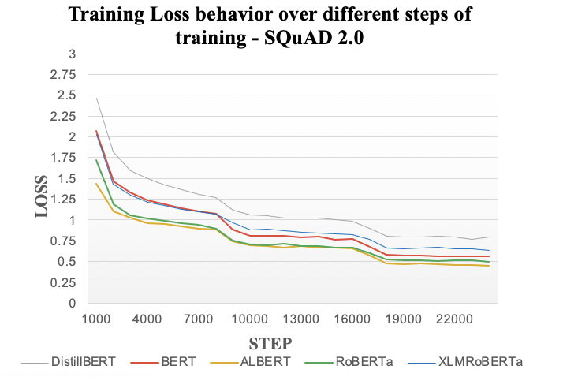
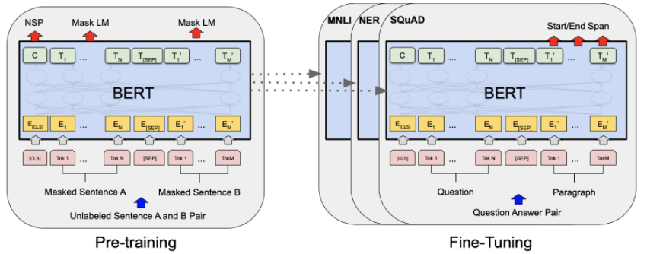
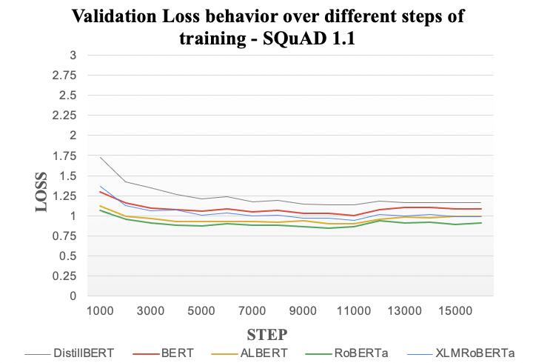
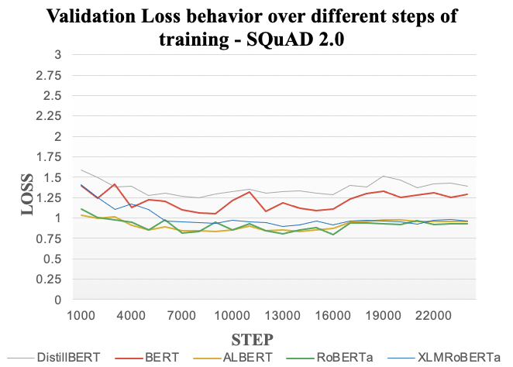

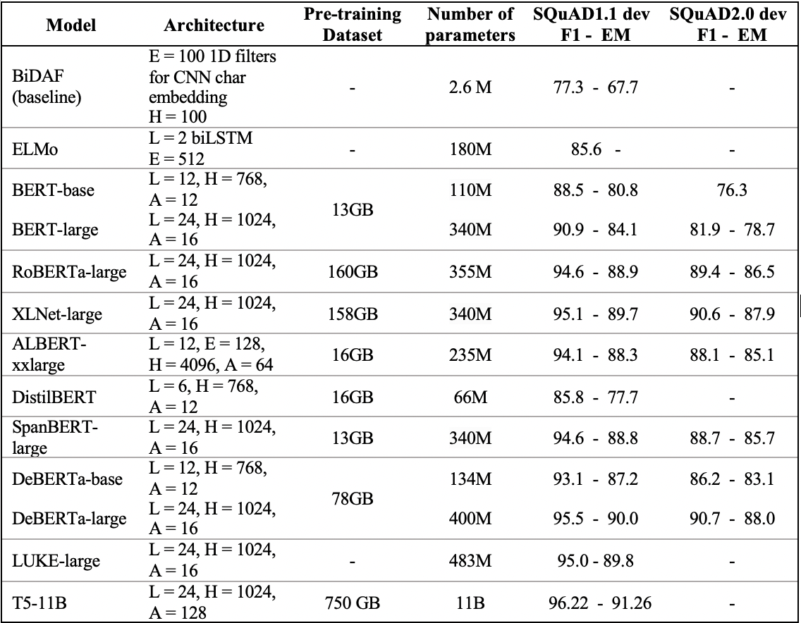
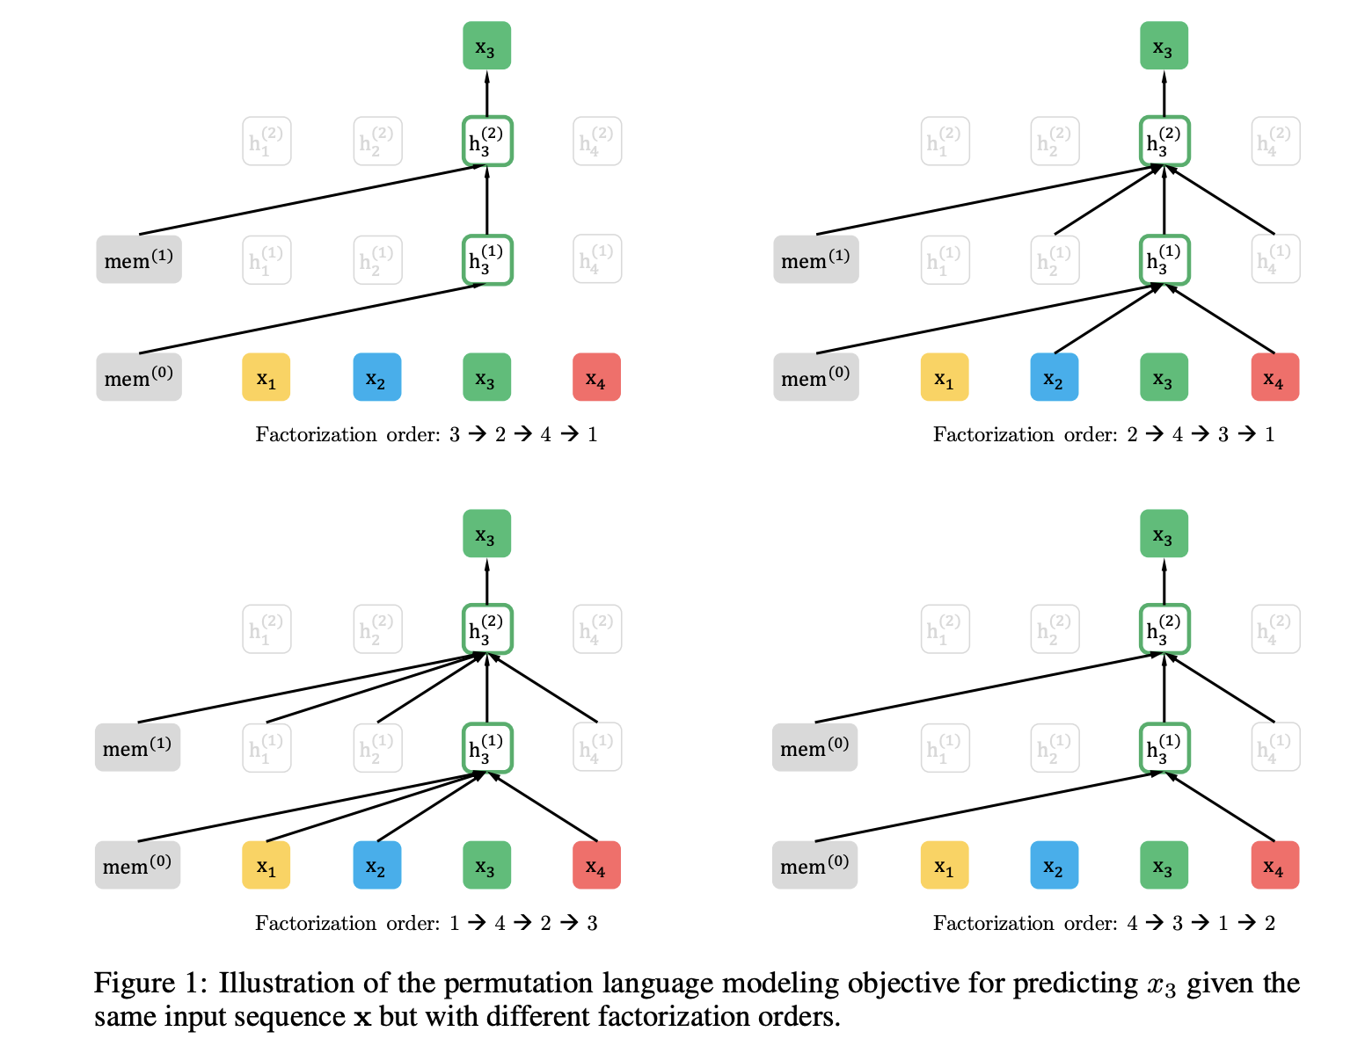
A Survey on State-of-the-art Models for Question Answering Tasks
Parisa Foroutan, Bahareh Amirshahi, Hamed Rismanian
Concordia University, HEC Montréal
Introduction
State of the art models for QA
Experiments
Question Answering Systems:
Question Answering (QA) is a task in Information Retrieval and Natural Language Processing domain, which aims to build models that get some textual, visual or audio data and a question as input and respond to that question.
A lot of QA Systems have emerged since the 1960s. These QA systems have tried to answer various types of user questions including Factoid, List, Definition, and Complex from which the factoid type is investigated in the current survey. Questions in this domain ask about a simple fact that can be answered in a few words.
In this section, we introduce the state of the art (mainly transformer) models that have been used for QA tasks.
Model Evaluation Metrics
Exact Match (EM): measures the percentage of predictions that match any one of the ground truth answers exactly.
F1 Score: measures the average overlap between the prediction and ground truth answer.
BiDAF [7] (Bidirectional Attention Flow) is a multi-stage hierarchical process that represents the context at different levels of granularity and uses bidirectional attention flow mechanism to obtain a query-aware context representation without early summarization. It uses a deep, bi-directional LSTM model to create word representations.
ELMo [8] (Embeddings from Language Models) utilizes a deep contextualized word representation which is character based, allowing the model to form representations of out-of-vocabulary words. It also adds a self-attention layer after the bidirectional attention component, simplifies some of the pooling operations and substitutes the LSTMs for gated recurrent units.
ALBERT [12] (A LITE BERT) incorporates two parameter reduction techniques: Factorized Embedding Parameterization and Cross-layer Parameter Sharing. Since large model architectures dictate that H ≫ E, factorized embedding parameterization unties the WordPiece embedding size E from the hidden layer size H allowing a more efficient usage of the total model parameters. This reduces the embedding parameters from O(V × H) to O(V × E + E × H).
Datasets:
Stanford Question Answering Dataset [1] (SQuAD) was created in 2016 and later revised to SQuAD 1.1. This dataset consists of 107,785 question-answer pairs on 536 Wikipedia articles posed by crowdworkers where the answer to each question is a segment of text from the corresponding reading passage. There are 23,215 paragraphs for the 536 articles covering a wide range of topics, from musical celebrities to abstract concepts. SQuAD dataset has partitioned the articles randomly into a training set (80%), a development set (10%), and a test set (10%).
Since the SQuAD dataset does not cover the situations where the questions are unanswerable, in 2018, the Stanford University constructed SQuAD 2.0 [2] dataset to overcome this shortcoming of SQuAD. This dataset adds 53,775 new, unanswerable questions which are relevant to the same paragraphs. SQuAD 2.0 was a more challenging natural language understanding task for existing models in 2019. These two datasets opened a new horizon for the researchers who are interested in QA tasks.
Table 3 – Experiment results on SQuAD 1.1 and SQuAD 2.0
Figure 10 – Effect of training size on F1 score
We tested five well-known transformer models on SQuAD 1.1 and SQuAD 2.0 under different settings such as max_len (sum of question and context lengths), doc_stride (the overlap between two chunks of splitting a long sequence), and training size shown in Table 3
The best performance on development sets for each model is shown in bold and for each dataset, the best performance is presented in blue.
Due to computational limitations, we only tuned our models with a few values for max_len and doc_stride. In general, results with doc_stride 128 is better than with 32.
To study the effect of training size in fine-tuning step on the performance of the models, we used 33%, 66%, and 100% of each dataset and the the results are shown in Figure 10 This experiment shows that DitilBERT and BERT models are more sensitive to the fine-tuning data size, especially for SQuAD 2.0 dataset.
Figure 8 - Parameter counts of several recently released pretrained language models
DistilBERT [13] is pre-trained with knowledge distillation, a compression technique in which a compact model (the student) is trained to reproduce the behaviour of a larger model (the teacher) or an ensemble of models. The distillation process includes removing the token-type embeddings and the pooler, reducing the number of layers, and using highly optimized linear algebra operations.
Figure 5 - ELMO architecture
BERT [9] (Bidirectional Encoder Representations from Transformers) combines the bidirectionality with use of transformers and can be considered an improvement to the previous state-of-the-art models. The authors pre-train BERT using Masked Language Modeling (MLM) and Next Sentence Prediction (NSP) tasks. MLM masks some percentage of the input tokens at random, and then predicts those masked tokens. This allows bidirectional training in models in which it was previously impossible. As some of the downstream NLP tasks such as Question Answering are based on understanding the relationship between two sequences, BERT is pre-trained for a binarized NSP task. The BERT model is first initialized with the pre-trained parameters, and all the parameters are fine-tuned using labeled data from the downstream tasks.
SpanBERT [14] differs from BERT as it masks adjacent random spans, rather than random tokens, and trains the span boundary representations to predict the whole content of the masked span, hence not relying on the individual token representations within it.
Table 1 – Dataset statistics of SQuAD 1.1 and SQuAD 2.0
Figure 1 - Benchmark datasets for QA tasks
Figure 11 Shows the behaviors of training and validation losses over different steps of training on SQuAD 1.1 and SQuAD 2.0. This representation is in accordance with the results of Table 3 confirming that RoBERTa is outperforming other models for QA tasks.
It can be seen that both training and validation losses for DistilBERT model is higher than the other models owing the fact that DistilBERT has a lower capacity relative to the others.
Another interesting observation from Figure 11 is that ALBERT with 235M parameters has a very close and comparable performance as our best model (RoBERTa) with 355M parameters.
Looking at the validation loss in Figure 11, although, the training loss is reducing consistently by the number of steps, one can conclude that around 12000 and 18500 training steps for SQuAD 1.1 and SQuAD 2.0 respectively are enough to get best performance.
Figure 2 – Distribution of maximum length of Question + Context in SQuAD 1.1
Figure 9 - An illustration of SpanBERT training
Transformers Background
DeBERTa [15] is a new model architecture that applies two novel techniques: Disentangled Attention Mechanism (DAM) and Enhanced Mask Decoder. DAM is a technique where each word is represented using two vectors that encode its content and position and the attention weights among words are computed using disentangled matrices based on their contents and relative positions. To incorporate the absolute position of words, Enhanced Mask Decoder, is used in the decoding layer for predicting the masked tokens in model pre-training.
Introduction of Recurrent Neural Networks (RNNs) broadened the horizon of NLP. Seq2Seq [3] models are a type of RNN models where the input sequence size can differ from the output sequence size. Therefore, it is one of the basic models for QA tasks. After Google announced the Attention mechanism in Transformers [4], suggesting that task-specific architectures are no longer necessary and transferring many self-attention blocks is sufficient, many transformer models were developed for NLP tasks such as Machine Translation, Text Summarization, Question Answering, etc. One of the first transformer-based NLP models is Open AI GPT [5] (Generative Pre-trained Transformer). The most recent GPT model is GPT-3 [6] with 175 billion parameters which would need no fine-tuning and only a few demonstrations to understand tasks and perform them.
Figure 6 - Overall pre-training and fine-tuning procedures for BERT
RoBERTa [10] (Robustly Optimized BERT Pretraining Approach) is a modified version of BERT which has been trained longer, with bigger batches, longer sequences, and over more data. RoBERTa utilizes Dynamic masking mechanism while BERT uses Static masking. The NSP task is eliminated in RoBERTa, leading to a slight improvement in performance of downstream tasks.
Other models: T5 [16] , XLMRoBERTa [17] , LUKE [18] , SG-Net [19]
Table 2 – Summary of models’ specification and performance
Figure 11 – Training Loss Behavior
XLNet [11] is a Generalized Autoregressive Pretraining language model that maximizes the expected log likelihood of a sequence w.r.t. all possible permutations of the factorization order. This ensures that the context for each position consists of tokens from both left and right directions and does not rely on data corruption.
Conclusion
In this survey, we have reviewed state-of-the-art transformer models for QA task applied on SQuAD 1.1 and 2.0 datasets. We tested five models, RoBERTa, ALBERT, BERT, XLMRoBERTa, and DistilBERT, and our experiments showed that RoBERTa-base pre-trained model has the best performance in terms of F1 and EM scores. Moreover, we examined the effect of training steps and training size on these models’ performance. We found that fine-tuning these models just for 2 epochs is enough to get our reported performance. Below is the output of an arbitrary question and context example from those models.
Context:
Question:
Answers:
"Piano sonatas are usually written in three or four movements, although some piano sonatas have been written with a single movement (Scarlatti, Liszt, Scriabin, Medtner, Berg), others with two movements (Haydn, Beethoven), some contain five (Brahms' Third Piano Sonata) or even more movements"
Figure 3 - Open AI GPT model
Figure 4 - The Transformer Model Architecture
1 - "How many movements do Beethoven’s piano sonatas have?”
2- "whose piano sonata has two movements?"
References:
[1] Rajpurkar et al. (2016)
[2] Rajpurkar et al. (2018)
[3] Sutskever et al. (2014)
[4] Vaswani et al. (2017)
[5] Radford et al. (2018)
[6] Brown et al. (2020)
[7] Seo et al. (2018)
[8] Peters et al. (2018)
[9] Devlin et al. (2019)
[10] Liu et al. (2019)
[11] Yang et al. (2020)
[12] Lan et al. (2020)
[13] Sanh et al. (2020)
[14] Joshi et al. (2020)
[15] He et al. (2021)
[16] Raffel et al. (2020)
[17] Conneau et al. (2020)
[18] Yamada et al. (2020)
[19] Zhang et al. (2019)
RoBERTa:
1- two
2- Hay dn , ĠBe eth oven
ALBERT:
1- ▁two
2- hay d n , ▁beethoven
BERT:
1- three or four
2- haydn , beethoven
DistilBERT:
1- three or four
2- Hay dn , ĠBe eth oven
Figure 7 – Permutation language modeling objective for predicting x3

